Slide 1
UGBA 141 Production and Operations Management
Queue III Pooling and Psychology
Professor Park Sinchaisri
Notes:
Agenda
Capability Analysis + Six Sigma
Ritz-Carlton Case
Service Excellence

Slide 2
Course Announcements
Great job with Littlefield! Work on your slides early! Agenda: Managing queues: Pooling + Psychology Monday: Revenue management + Uber guest speaker
Tuesday: Submit Project Slides (ppt/pdf) by 11:59pm
Wednesday: Project Presentation (7 min/team)
Friday: Littlefield Strategy Slides due 11:59pm (4 slides)
Final Week: Monday: Littlefield + product management
Tuesday: HW5 due
Wednesday: Wrap-up + Final Flash Review (+ bonus points)

Slide 3
Next Week’s Slides
Tuesday: Submit Project Slides (ppt/pdf) by 11:59pm
Grading criteria in email/on bCourses/Assignments
7 mins: motivation, approach, recs, connections
Order of presentations to be announced
Wednesday: Project Presentation (7 mins) + 1 Q&A
Friday: Littlefield Strategy Slides (ppt only) due 11:59pm
4 slides: machine purchase / Q / R / end game
Put explanations in notes, Details in handout/bCourses
Debrief Mon 4/25, random one slide from each team

Slide 4
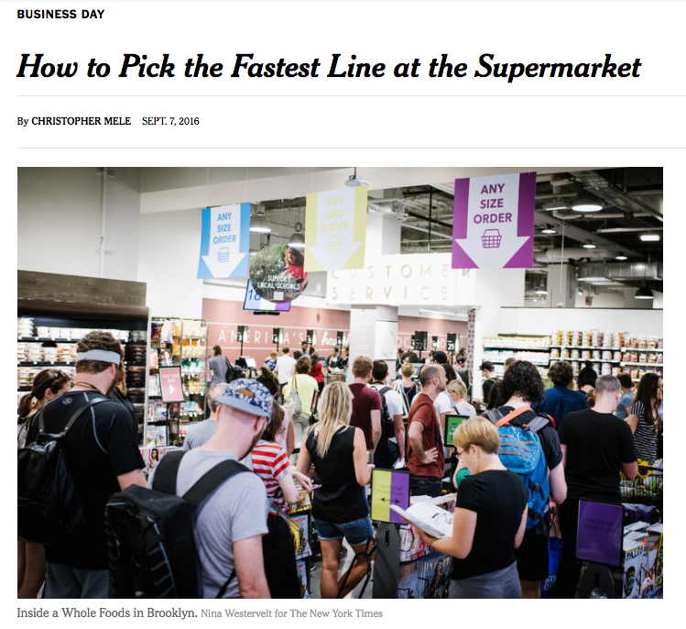
“Choose a single line that leads to several cashiers”
Notes:
A recent NYT article gave some advice on how to pick the fastest line at the supermarket. One of the tips is that [READ]

Slide 5
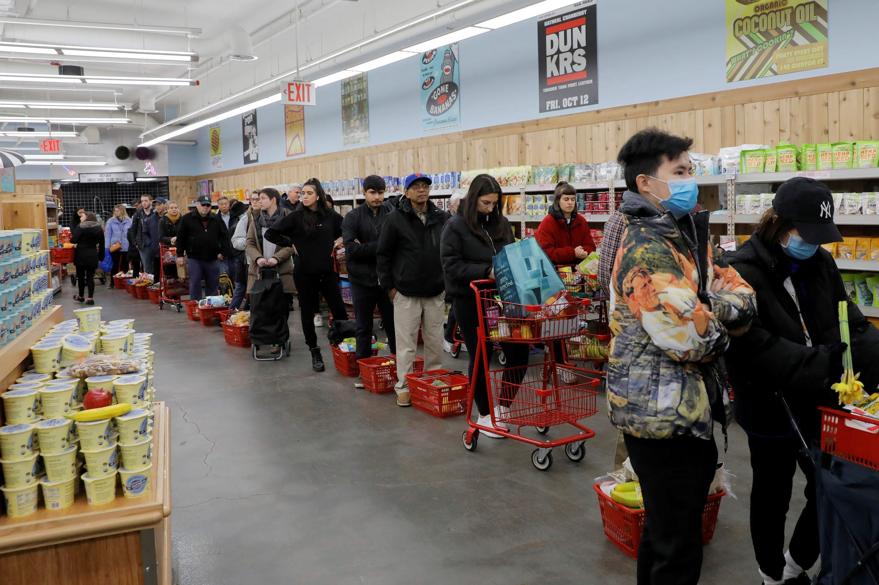
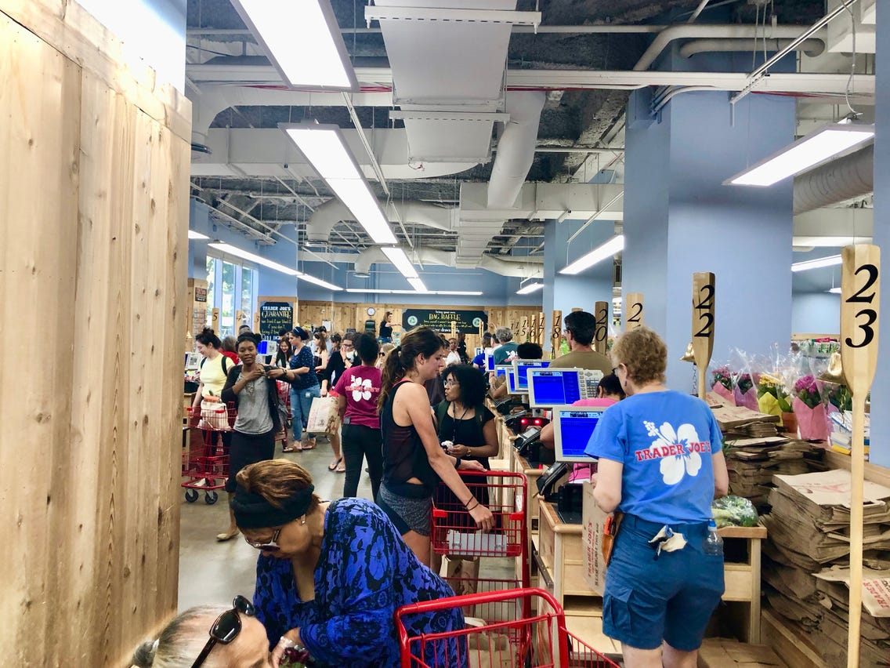
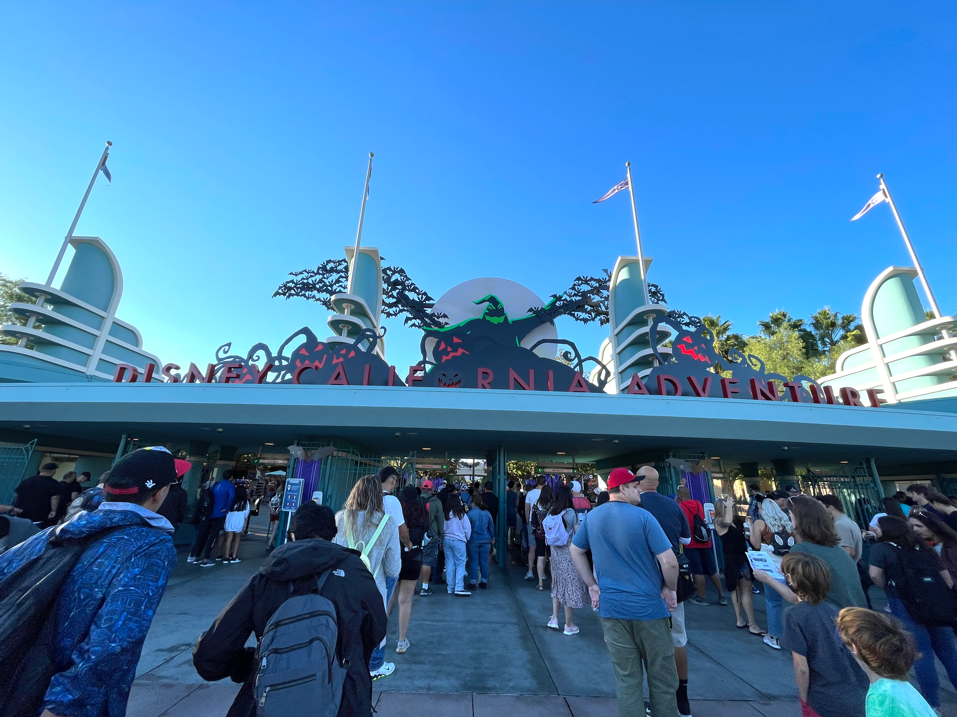
Parallel vs Pooled
Trader Joe’s San Francisco
Pooled system:
If delays are random, delays will only affect a single server, rather than the entire line.
If there are delays at one server, it affects the entire line.
Disney California Adventure Park
Parallel queue system:
Notes:
You probably have seen these immigration lines at airports before. They’re pretty sad. Here are the two most common queue structures used in practice. On one side you have airports like Thailand’s Suvarnabhumi International Airport in Bangkok where they opt to do a single line serving multiple officers. The person at the head of the line goes to the first available window in a system often seen at airports or banks. This kind of queue, as you probably have seen from Whole Foods and Trader Joes, is what previous research has shown to be the fastest.
While the others like Saudi Arabia’s King Abdul Aziz International Airport, which by the way is rated as the best airport in the world, implement a dedicated or parallel queueing system. In reality, you’ve probably seen a hybrid.
Which one is better?
If delays are random, delays will only affect a single register rather than the entire line. While in the parallel case, if there are delays at one register it affect the entire line.
So a single line for multiple servers would most efficiently channel people toward the next available worker. The efficiency here I talked about is the wait time. That is, a system in which multiple servers pull from the same queue will offer a shorter wait at the same level of utilization as a system in which customers stand in separate lines
Getting into a single line also provides a sense of psychological relief because it eliminates the choice of where to go and second-guessing about the best line to choose.
a single line for multiple servers would most efficiently channel people toward the next available worker.
The efficiency here I talked about is the wait time. That is, a system in which multiple servers pull from the same queue will offer a shorter wait at the same level of utilization as a system in which customers stand in separate lines
Studies had typically shown that with three servers, each serving his or her own line of customers, the wait time was three times longer on average than a single line leading to an array of servers.
So just rearranging how people stand can offer shorter waits without hiring more workers or adding more capacity.

Slide 6
Which System is More Effective?
Pooled system:
One queue, four servers
a = 35
m = 4
Across these 3 types
Variability is the same: CV_{a} = 1, CV_{p} = 1.25
Total demand is the same: 1/35 customers per second.
Processing time is the same: p = 120
Utilization is the same: p / a x m = 85.7%
The probability a server is busy is the same = 0.857
Partially pooled system:
Two queues, two servers with each queue
For each of the 2 queues:
a = 35 x 2 = 70
m = 2
Parallel queue system:
Four queues, one server with each queue
For each of the 4 queues:
a = 35 x 4 = 140
m = 1
Notes:
We can actually use the formula we just learned to compare three systems
Across these 3 types of systems, given the same variabilities, same average demand and processing time. They have the same utlization.

Slide 7
Pooling Reduces Time in Queue
Pooled system:
a = 35, p = 120, m = 4, CV_{a} = 1, CV_{p} = 1.25
T_{q} = 193
Flow Time = 193 + 120 = 313
Partially pooled system:
For each of the two queues:
a = 70, p = 120, m = 2, CV_{a} = 1, CV_{p} = 1.25
T_{q} = 430
Flow Time = 430 + 120 = 550
Parallel queue system:
For each of the four queues:
a = 140, p = 120, m = 1, CV_{a} = 1, CV_{p} = 1.25
T_{q} = 921
Flow Time = 921 + 120 = 1,041

Slide 8
Pooling Reduces # Waiting not # in Service
Pooled system:
I_{q} = 5.5
I_{p} = 3.4
I_{q} = 5.5
I_{p} = 3.4
Inventories for each queue within the system
Partially pooled system:
I_{q} = 6.1
I_{p} = 1.7
I_{q} = 12.3
I_{p} = 3.4
(2 times each queue)
Inventories for the total system
Parallel queue system:
I_{q} = 6.6
I_{p} = 0.86
I_{q} = 26.3
I_{p} = 3.4
(4 times each queue)

Slide 9
Pooling Why It Works
= A customer waiting
= A customer in service
Pooled system
Parallel queue system
Both systems currently have 6 customers.
Pooled: all servers are busy and only 2 customers are waiting.
Parallel: 2 servers are idle and 4 customers are waiting.
The parallel queue system is inefficient because there can be customers waiting and idle servers at the same time.
Notes:
Read the slide.
If doing a single line is the best thing, Why do we still see places that have a so-called less efficient parallel line model?
Well, most people still prefer to take their chances with parallel even though most of the time they end up picking a slower line.

Slide 10
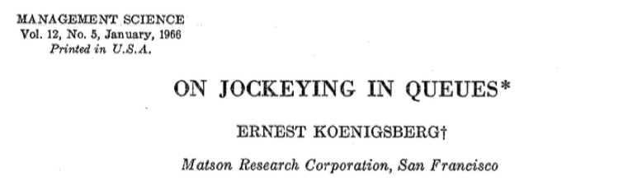
Have We Been Realistic?
cashier
customers
Arrival rate to each separate queue is independent of the state of the system
Servers perform identically, regardless of queue structure
If customers can choose,
there is no difference in the average wait between the systems.
Notes:
Of course, there are some caveats here that researchers have been conveniently ignoring.
Most research assumed all workers perform identically regardless of queue structure. Having dedicated queues might influence how servers work.
the arrival rate to individual queues in a system with separate queues is independent of the state of the system.
That is, there are customers who are destined to go to Server 1 and they will get in line for Server 1 even if Server 1 has a line with 3 customers waiting while Server 3 is sitting idle.
That might be reasonable for, say, a bank having customers call a nationwide call center as opposed to their local branches. It is not really appropriate for a setting in which customers see the state of each queue and can chose the one that is shortest.
Indeed, if we allow customers to see the queues before they join and then jump between queues if one is moving faster, then there is no difference in the average wait between the systems (although issues of fairness and stress are relevant).
We then have two countervailing effects. Pooling leads to shorter waits assuming that the service rate doesn’t change BUT pooling can lower the service rate, making workers work more slowly.
Now we move to a very different topic. In managing queueing systems, perceptions are as important as reality. One theory stipulates that ...
If you expect a certain level of service, and perceive the service received to be better, then you will be a happy customer.
Therefore, achieving customer satisfaction also depends on managing customer’s perception of service.

Slide 11
Psychology of Queueing: Supply Side

Slide 12
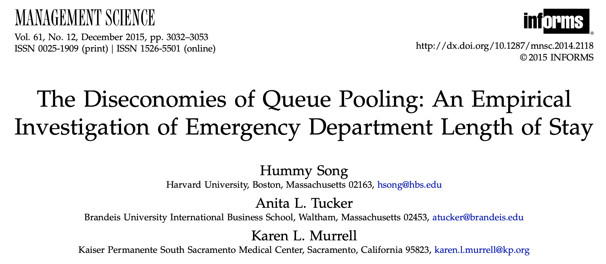
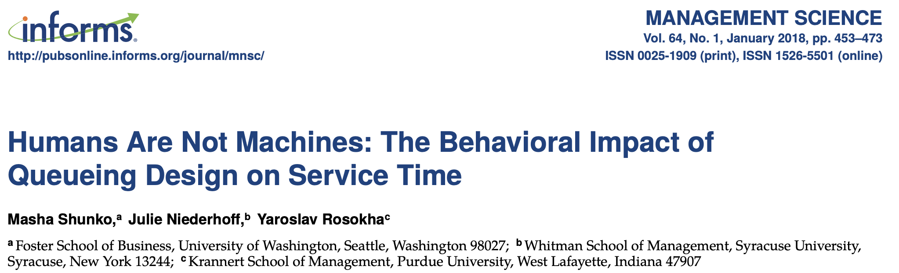
Pooling Can Be Worse
Notes:
I will briefly talk about two papers that found empirical and experimental evidence that pooling can lead to suboptimal outcome

Slide 13

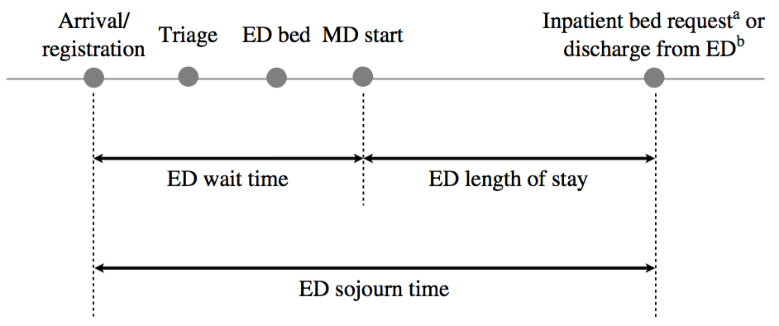
Diseconomies of Pooling in ED
Outcomes
Pooled: Physician assigned to patient once placed in bed
Parallel: Physician assigned to specific patients at triage
New policy: Pooled → Parallel
In only one part of a hospital’s ED, but not the other
Difference-in-Difference estimation
Source: Song, Tucker, and Murrell “The Diseconomies of Queue Pooling” (2015)
Notes:
In this paper, the authors investigate queue management in the setting of a hospital's emergency department.
In the ED, it is more common to have a pooled system in which physicians are assigned to patients once they’re placed in their ED beds. On the other hand, dedicated system is one in which physicians are assigned to specific patients at the point of triage. While patients are moving from that point to the beds, the physicians already know who they have to treat.
In the focal hospital, there was a recent policy change. One part of the ED is switching from pooled to dedicated system. The fact that the change affected only one part of the ED, allows them to use a difference-in-differences approach to empirically test the impact of a change in the structure of the queuing system on the average wait time to be seen by an ED physician and the average length of stay (LOS) in the ED.
The authors measured throughput time based on individual patients' length of stay in the ED, starting with arrival to the ED and ending with a bed request for admission to the hospital or the discharge of a patient to home or to an outside facility.

Slide 14
Parallel Q Reduces LOS by 10%
= 32 minutes
Pooled vs Parallel
Measure:
ED wait time
ED length of stay
patient discharge rate
Controls:
patient’s condition
state of ED
physician’s practice experience
Why?
Greater visibility into one's workload
Increased ability for physicians to manage patient flow.
Increased ownership over patients
Source: Song, Tucker, and Murrell “The Diseconomies of Queue Pooling” (2015)
Notes:
The findings show that, on average, the use of a dedicated queuing system decreased patients' lengths of stay by 10 percent. This represented a 32-minute reduction in length of stay—a meaningful time-savings for both the emergency department and patients.
ASK WHY?
The benefits of a dedicated queuing system may be due to greater visibility into one's workload and the increased ability for physicians to manage patient flow.
Physicians increased ownership over patients

Slide 15
Humans Are Not Machines
“Beware lines with obstructions”
Source: Shunko, Niederhoff, and Rosokha “Humans Are Not Machines” (2017)
Notes:
Another tip from the NYT article I showed earlier is that, beware lines with obstructions. Think about when you go to Trader Joe’s and the line is so long that it snakes around corners of the store. In such case, the servers’ or cashier’s view of the number of customers is obstructed by a wall or a shelf.
This paper shows that obstructions lead to a longer wait because they hin ฮิน der the feedback the cashiers would get from seeing how their work thins the line.

Slide 16
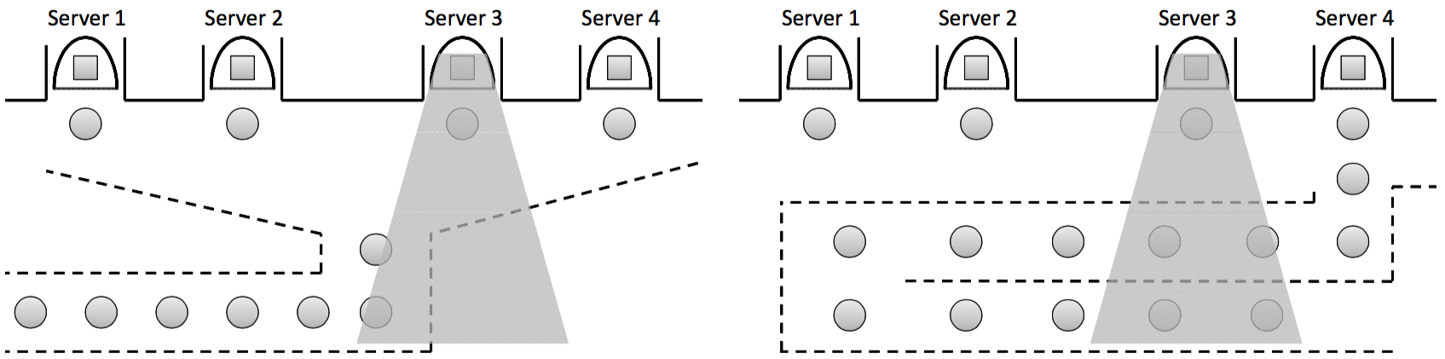
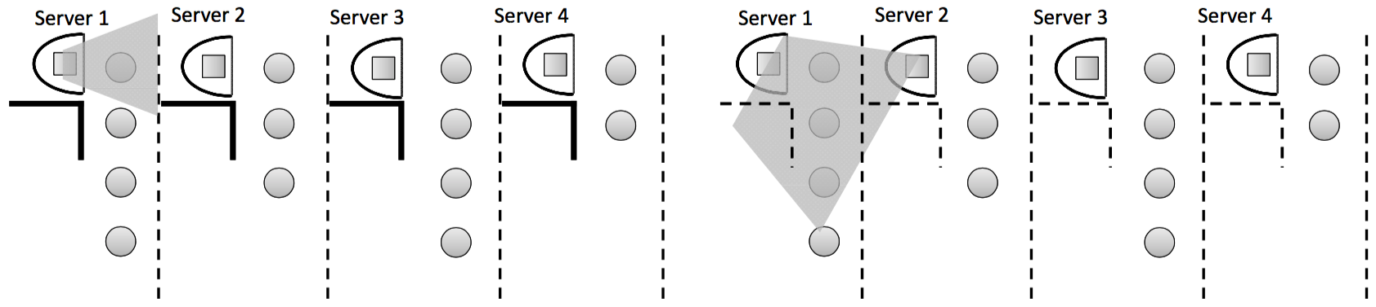
Virtual Grocery Store
(N=729, lab + online)
Queue-Length Visibility
Blocked
Full
Pooled
Queue
Structure
Parallel
Source: Shunko, Niederhoff, and Rosokha “Humans Are Not Machines” (2017)
Notes:
The authors ran a series of experiments [[both online through MTurk and in person. They created a virtual grocery store checkout line and recruited participants to act as cashiers.
They are randomly assigned to one of the 4 conditions, the first 2 are either pooled or parallel like usual, they call these as "full visibility"
then we have the blocked visibility groups, with either pooled or parallel
The interface was simple: a box on the left side of the screen showed avatars for the participant and three computer-generated cashiers, each of whom had a dedicated line of customers. The right side of the screen had five sliders representing five variably priced grocery items, which they would ring up by setting the slider to the correct price. The computerized customers lined up in either a single queue or the shortest of the four available queues.

Slide 17
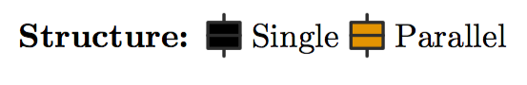
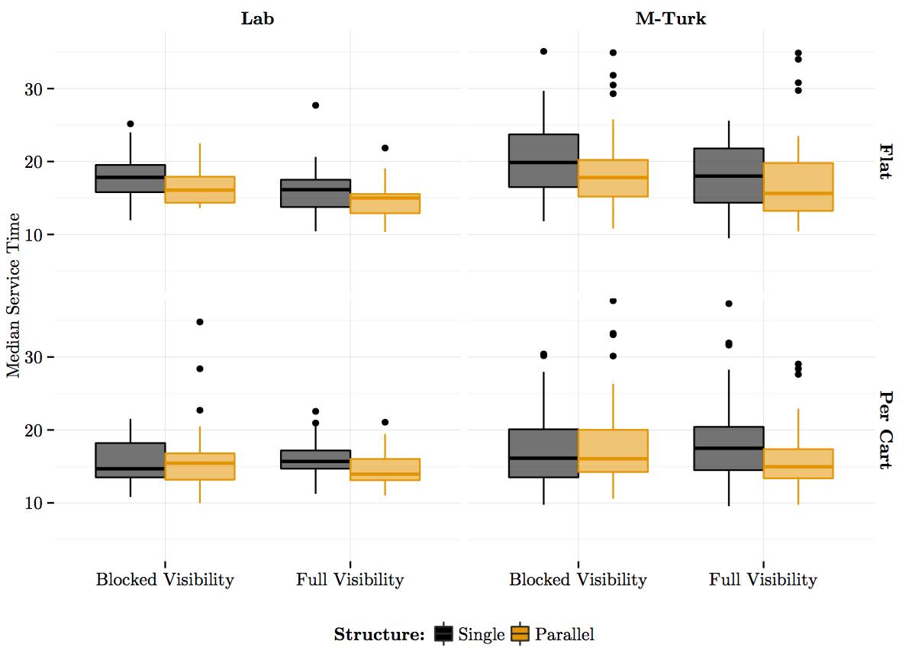
Parallel Q Moves Faster
(Visible)
Waiting time
Good visibility of queue’s length is needed (feedback)
Workers feel they’re responsible for the line’s progress
Competition among servers
Notes:
Here is the result of the regression, done separately for each population.
Parallel line has a negative effect on wait time which is a good thing. This shows a drawback of pooling.
Blocked visibility leads to a longer wait time as it slows down the servers.
Parallel lines move faster than the single lines
The authors think the key lies in making workers feel they’re responsible for the line’s progress. Give them their own line and suddenly they have a direct impact on how fast it moves.
With a single queue everyone works together to move the line along, which makes each individual less motivated to work quickly. In order to see that impact, workers have to have a full view of the line.
Towers of merchandise and display cases often block a cashier’s view of the customers. Removing those visual barriers motivates people to work faster because they are getting immediate feedback—they can watch their line shrink.
There may also be an element of competitiveness. If a cashier can see how his or her line compares with everyone else’s, a checkout area can become the finish line of a race, with each cashier striving to be the fastest. That competition means faster, more efficient service for customers.

Slide 18
Psychology of Queueing: Demand Side

Slide 19
Design for Perception
Unoccupied time feels longer than occupied time
Preprocess waits feels longer than in-process waits
Anxiety makes waits longer
Uncertain waits are longer than known, finite waits
Unexplained waits are longer than explained waits
Unfair waits are longer than equitable waits
The more valuable the service, the longer people will wait
Solo waiting feels longer than group waiting
Source: Meister “The Psychology of Waiting Lines” (2005)
Notes:
These are eight principles that organizations can use to influence customer perception of waiting time.
go through each. make sense.
if you keep yourself busy, time flies.
an example?
anxiety makes things worse. (baby sick, waiting to see doctor)
if you don’t know what is going to happen, the wait feels longer (airline passengers on runway)
giving people why it takes so long may make people feel better
social justice is important. first in first out. when a new server becomes available in multi-line system
Based on these principles, what are some of the solutions that you can come up with to manage perception?

Slide 20
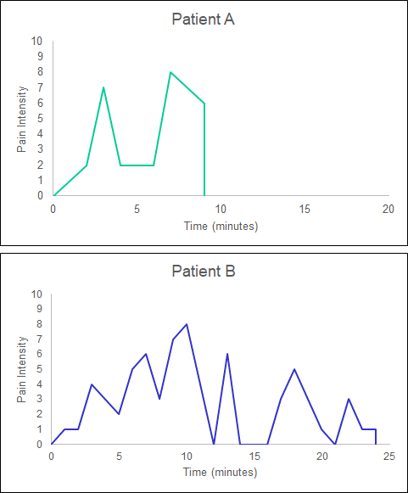
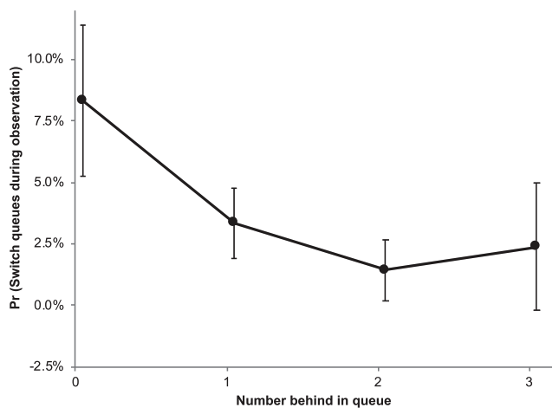

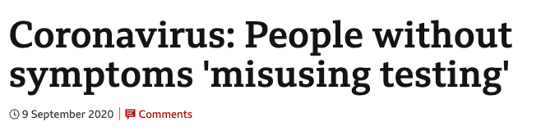

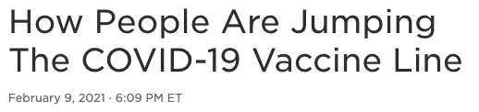
Recent Findings
Last-Place Aversion:
Waiting in last place diminishes wait satisfaction while increasing P(switching) and P(abandoning queues)
Queue transparency
Lying Aversion:
In priority queues where people make deceitful claims to access service faster:
Always route high claims to the high-priority class, but also…
Upgrade some low claims to the high-priority class to incentivize honesty
Source: Buell (2021), Rodriguez, Ibrahim, and Zhan (2021)
Notes:
Here are some of the ways to manage customer perception of wait.
example:
mirrors near elevators (people will look into the mirror and put on a more cheerful face)
sometimes, it makes sense to tell people how much time they will wait.
McDonald’s keeping idle workers out of sight
friendly server is important
it takes many good days to change a customer’s perception, so take a long-term view.

Slide 21
Design for Memory
Recollections of service experiences are based on:
Trend + High & Low Points + End
Peak End Rule: Customers remember their experience primarily how they felt at the peak and at the end
Duration Neglect: The duration of the experience matters far less than the peak-end moments
Service Design:
Finish strong
Get bad experiences out of the way early
Segment the pleasure, combine the pain
Source: Redelmeier and Kahneman (1996), Redelmeier, Katz, Kahneman (2003)

Slide 22
Managing Queues Summary
Two elements in managing service systems
Hard, quantitative side: capacity, waiting time, losses…
Soft, qualitative side: how workers and customers interpret and feels about encounter queueing
In any service encounter, “perception is reality” – need to consider how workers and customers perceive the experience
Workers are influenced by feedback, visibility, ownership, competition
Customers’ satisfaction depend on perception and memory
Design: Anticipate emotions in each service step, design service response anticipating these emotions, simplify by focusing on strong emotional positives and negatives and the end.
Notes:
Variability is the norm, not the exception
understand where it comes from and eliminate what you can accommodate the rest
Variability leads to waiting times although utilization < 100%
Although capacity is expensive, having some safety capacity is necessary
Use quantitative tools (e.g., waiting time formula) to
get a qualitative feeling of the system
analyze specific recommendations / scenarios
Design for consumer perception: Map out sequence of main steps in service process, anticipate customer emotions in each step, design service response, anticipating these emotions; simplify by focusing on strong emotional positives and negatives

Slide 23
What’s Next
Monday: Revenue management + Uber guest speaker
Tuesday: Submit Project Slides (ppt/pdf) by 11:59pm
Wednesday: Project Presentation (7 min/team)
Friday: Littlefield Strategy Slides due 11:59pm (4 slides)
Discussion reviews RM + final exam #1
Final Week of Classes
Monday: Littlefield debrief + product management
Tuesday: HW5 due
Wednesday: Final Flash Review (+ bonus points)
Friday: Discussion reviews final exam #2

Slide 24
Appendix

Slide 25
Scheduling/Prioritization
Triage: Sorting customers / patients / flow units to determine their priority and their sequence in the queue
First-Come-First-Serve
Triage Step
Inventory
Resource
Order of the sign-ups:
A -> B -> C -> D
Service times:
A: 9 minutes B: 10 minutes C: 4 minutes D: 8 minutes
Total wait time: 9+19+23 = 51 min
A
9 min.
B
19 min.
C
23 min.
D
Time to complete: 9+10+4+8 = 31 minutes
Notes:
easy to implement
perceived fairness (low variability in waiting time)

Slide 26
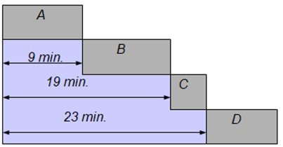
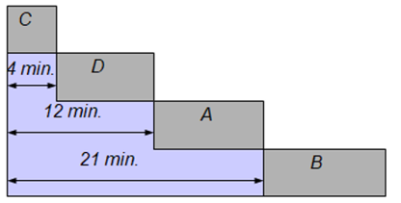
Scheduling SPT Rule
Shortest Processing Time (SPT)
Minimizes average waiting time
C → D → A → B
Service times:
A: 9 minutes B: 10 minutes C: 4 minutes D: 8 minutes
Total wait time: 9+19+23 = 51 min
Total wait time:
4+13+21=38 min
A
C
9 min.
B
4 min.
D
19 min.
C
12 min.
A
23 min.
D
21 min.
B
Time to complete: 9+10+4+8 = 31 minutes
Time to complete: 9+10+4+8 = 31 minutes
FCFS
SPT
Notes:
Problem of having “true” processing times ahead of time
Fairness

Slide 27
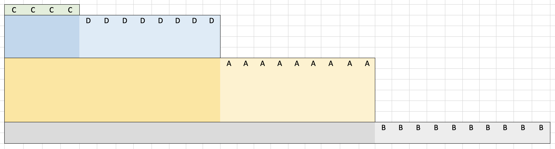
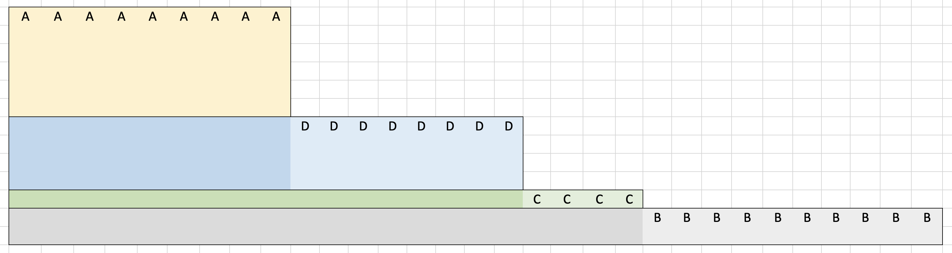
Scheduling Weighted SPT
SPT: C → D → A → B
Weighted SPT: Sequence based on importance
Service times:
A: 9 minutes B: 10 minutes C: 4 minutes D: 8 minutes
Cost/min
6 2 1 4
Ratio
0.67 0.2 0.25 0.5
Total wait time:
4+13+21=38 min
4
Cost
13
Total cost:
4 x 4 + 13 x 6 + 21 x 2 = 136
21
Time to complete: 31 minutes
Total wait time:
9+17+21=47 min
Cost
9
Total cost:
9 x 4 + 17 x 1 + 21 x 2 = 95
17
21
Notes:
emergency cases
identifying profitable flow units
$/min at bottleneck

